Slide 1
Solution
Design Application Architecture

Slide 2

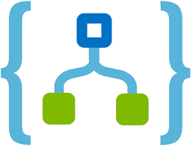








Email
Logic App
Internet
Storage
Account
Event
Grid
Service Bus
Function
Product
Database
Image
App Service
Website
Scanning API
On-Premises

